Slide 1
Employee Data Analysis using Excel
STUDENT NAME: Yuvashree H
REGISTER NO: 312217094 /asunm1659312217094
DEPARTMENT: B.Com ( General)
COLLEGE: Shri Krishnaswamy college for women

Slide 2
PROJECT TITLE
Visualizing Employees attendance trends with Excel charts

Slide 3


AGENDA
Problem Statement
Project Overview
End Users
Our Solution and Proposition
Dataset Description
Modelling Approach
Results and Discussion
Conclusion
3/21/2024 Annual Review

Slide 4

PROBLEM STATEMENT
Organizations struggle with monitoring and analyzing attendance data due to its complexity and volume. There is a need for a visualization tool that provides real-time insights into attendance patterns, identifies trends, predicts future patterns, and offers customizable reporting. Such a tool would enhance decision-making and improve workforce management.

Slide 5

PROJECT OVERVIEW
The project aims to develop a visualization tool for analyzing employees' attendance trends. It will offer real-time data visualization, identify patterns and trends, predict future attendance, and provide customizable reports. The goal is to improve decision-making and optimize workforce management through clear, actionable insights.
.

Slide 6

WHO ARE THE END USERS?
The end-users of visualizing employees' attendance trends include HR managers, department heads, and senior leadership. HR managers use the tool to track and address attendance issues, department heads monitor team performance, and senior leadership leverages insights for strategic decision-making and resource planning.

Slide 7

OUR SOLUTION AND ITS VALUE PROPOSITION
Our solution provides an intuitive visualization tool that transforms complex attendance data into clear, actionable insights. By offering real-time updates, trend analysis, and predictive analytics, it helps HR managers and leaders make informed decisions, improve workforce management, and optimize resource allocation. This tool enhances efficiency and strategic planning within the organization.

Slide 8
Dataset Description
The dataset for visualizing employees' attendance typically includes two key files: 1. Employee Attendance Records: Contains detailed logs of employee attendance, including dates, times, and status (e.g., present, absent, late) for each employee. 2. Employee Information File: Provides metadata about employees such as employee ID, department, role, and employment status to contextualize attendance data and enable detailed analysis.

Slide 9

THE "WOW" IN OUR SOLUTION
Our solution stands out by offering a highly interactive and intuitive dashboard that simplifies complex attendance data into actionable insights. With real-time updates, trend analysis, and predictive capabilities, it provides HR managers and leaders with powerful tools for proactive decision-making and strategic workforce management, ultimately enhancing organizational efficiency and employee engagement.
3/21/2024 Annual Review
9

Slide 10
MODELLING
Modeling the visualization of employee attendance trends involves creating interactive charts and graphs that display real-time attendance data, identify trends, and predict future patterns. It includes aggregating data from attendance records, applying statistical analysis to recognize patterns, and designing user-friendly interfaces for easy exploration and reporting of insights. This model helps in monitoring attendance patterns and making data-driven decisions.
10

Slide 11
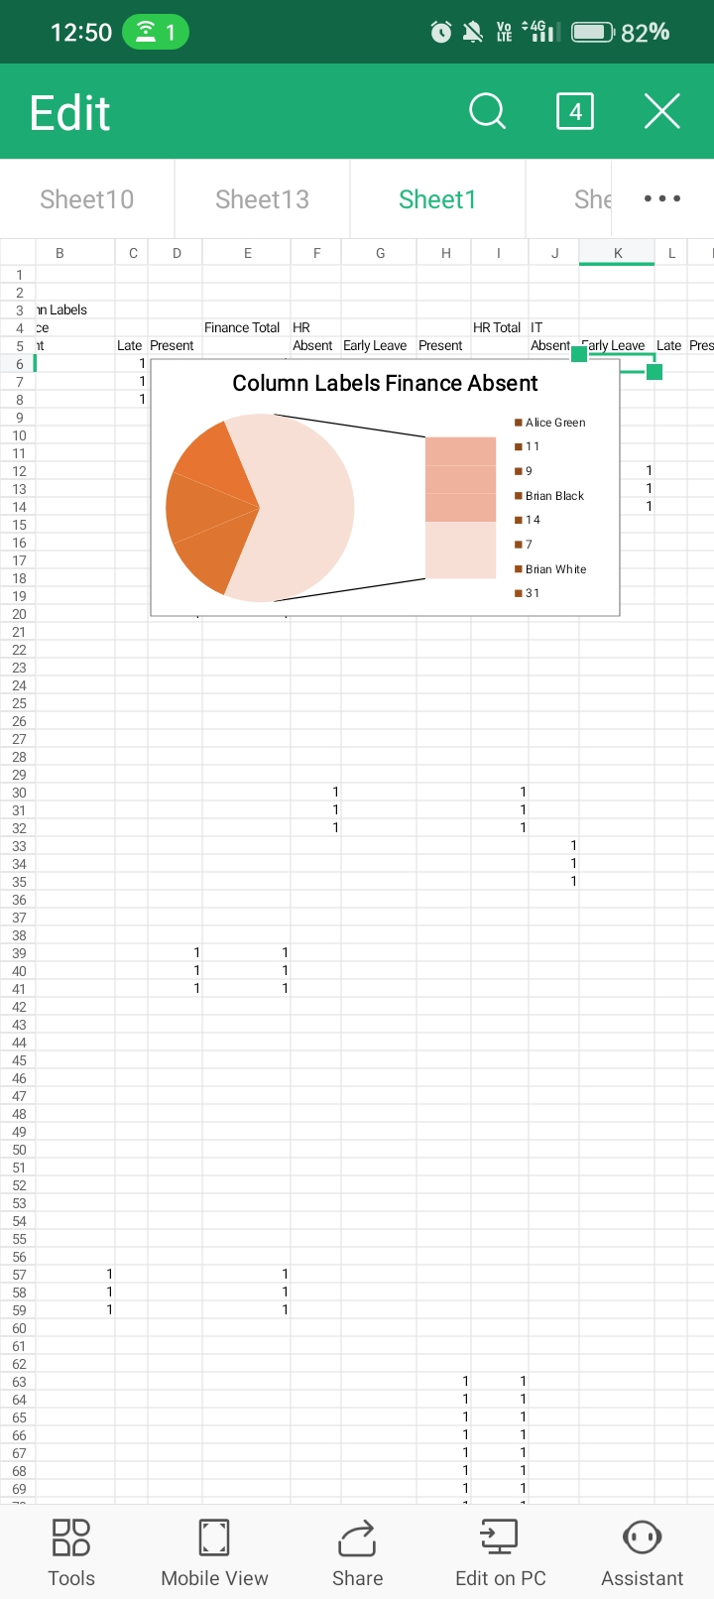
RESULTS
11

Slide 12
conclusion
Visualizing employee attendance trends involves analyzing patterns in attendance data over time to identify key insights. This can reveal trends such as seasonal fluctuations, periods of high or low attendance, and correlations with specific events or policies. By examining these trends, organizations can better manage workforce resources, improve attendance policies, and address any issues that may affect employee presence.

